Slide 1
HIGH SCHOOL
Where do I begin?!

Slide 2
Graduation Requirements:
24 credits TOTAL to graduate
18.5 from required courses/credits
5.5 from additional elective courses/credits

Slide 3
State Universities (also known as Regents universities)
Emporia State University Fort Hays State University Kansas State University Pittsburg State University University of Kansas Wichita State University

Slide 4
Kansas Regents Qualified Admission Curriculum
» English – 4.0 credits
» Math – 3.0 credits
» Science – 3.0 credits › 1.0 credit Life Science, 1.0 credit Physical Science, 1.0 credit Science elective
» Social Studies – 3.0 credits
If you are not interested in attending one of the Regents universities, be sure to look at their website for admission requirements!

Slide 5
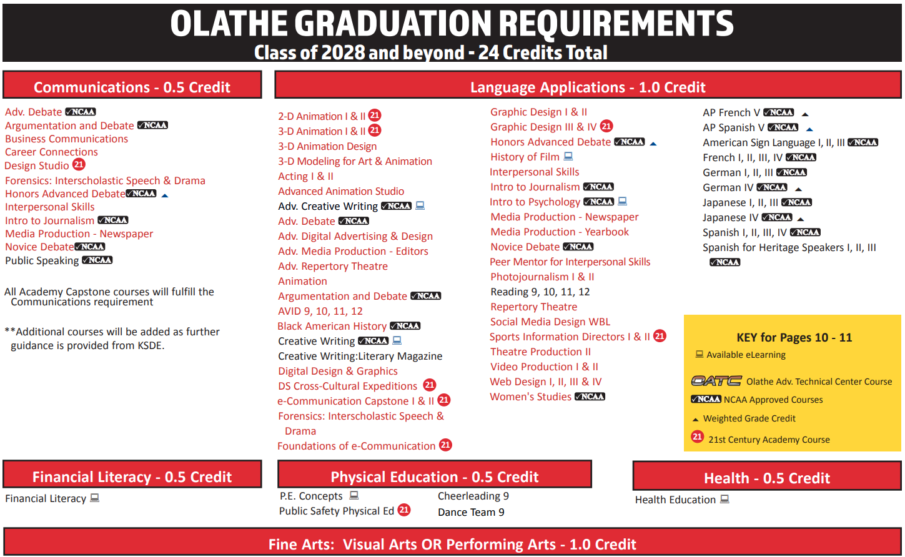
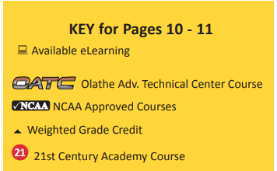
Program Planning Guide (PPG)
Classes in RED count in more than one category.
For example: Basic Digital Photography could count towards Fine Arts, Life Studies OR STEM.

Slide 6
Required Courses

Slide 7
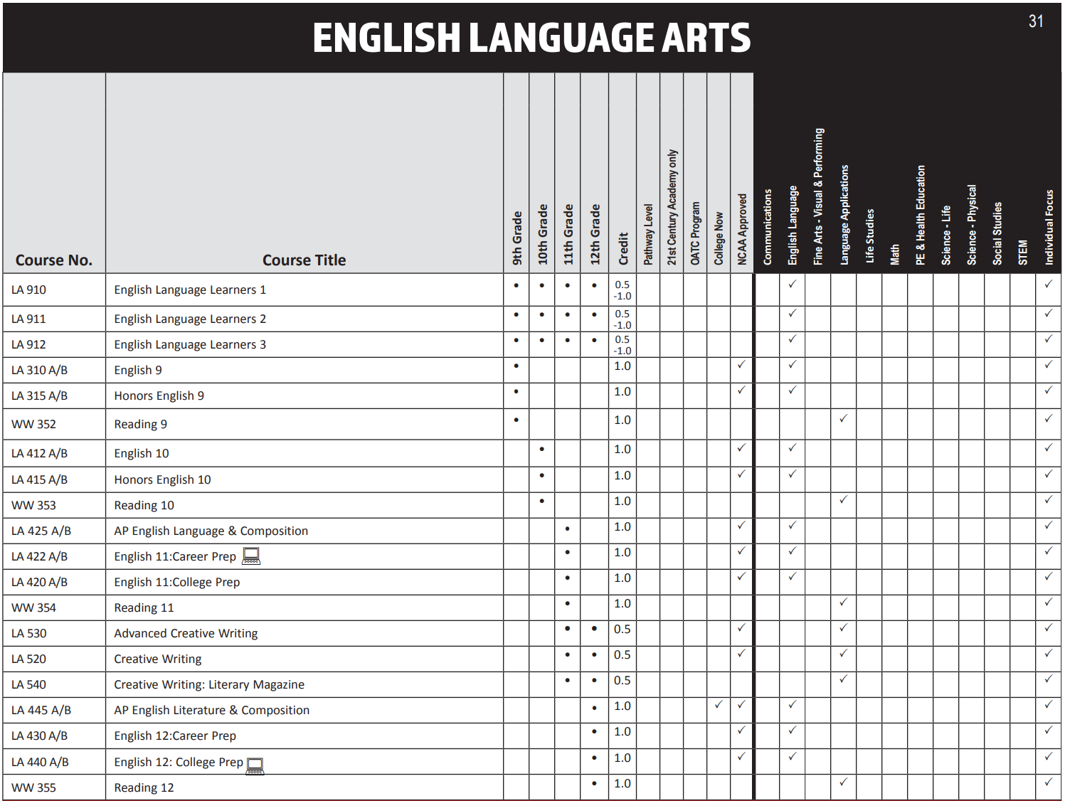
English Language Arts Page 31
Kansas Regents Qualified Admission Curriculum – 4.0 credits

Slide 8
How do I know if Honors English is for me?
Able to handle frequent homework that includes reading, writing or both
Able to cite textual evidence (formal and informal)
Advocates for self
Has a desire to look deeply/critically into a text
Able to handle long-term inside and outside reading projects
Willing to read aloud and share ideas with classmates
Willing to complete a summer reading and writing assignment

Slide 9
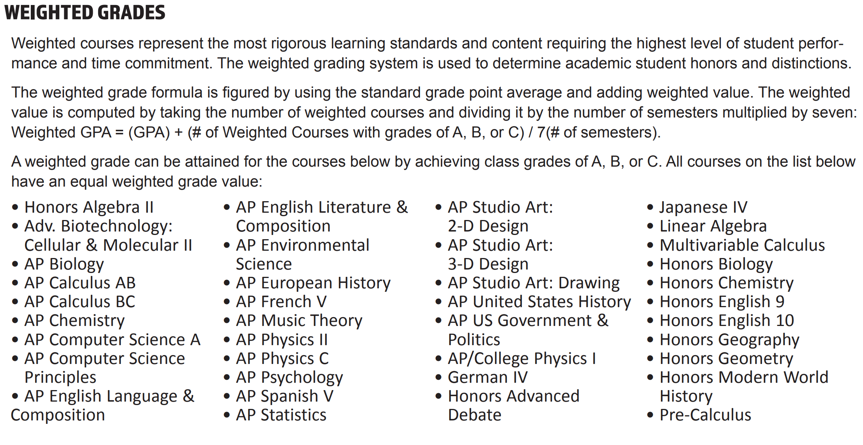
Weighted Grades – page 6

Slide 10
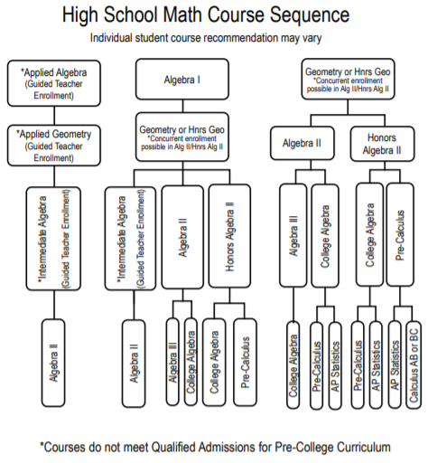
Mathematics Page 47
Your current math teacher determines your math class for next year!
Freshman
Sophomore
Junior
Kansas Regents Qualified Admission Curriculum – 4.0 credits OR 3.0 credits + 22 ACT Math score
Senior

Slide 11
Science Page 51
Freshman Choices: Biology OR Honors Biology
Graduation Requirements: » 1.0 credit Life Science » 1.0 credit Physical Science » 1.0 credit your choice (Life or Physical)
Life Science Classes:
› Anatomy & Physiology › AP Biology › AP Environmental Science › College Biology › Genetics & Biotechnology › Horticulture › Student Naturalist
Physical Science Classes:
› AP Chemistry › AP College Physics › Astronomy › Chemistry › Physical Science › Physics › Physical Science Investigations
Kansas Regents Qualified Admission Curriculum – 3.0 credits

Slide 12
Science Sequence Options
Science – only because I have to:
» 9th Grade: Biology
» 10th Grade: Physical Science » 11th Grade: Student Naturalist or Horticulture
Science – it’s okay:
» 9th Grade: Biology » 10th Grade: Chemistry
» 11th Grade: Physics
» 12th Grade: College/AP Chemistry or Biology
Science – I LOVE IT!!!
» 9th Grade: Honors Biology
» 10th Grade: Honors Chemistry
» 11th Grade: Physics
» 12th Grade: AP Physics, AP or College Biology, AP or College Chemistry, Anatomy & Physiology, AP Environmental Science
Kansas Regents Qualified Admission Curriculum – 3.0 credits

Slide 13
Social Studies Page 62
Freshman Year: 1.0 credit » Modern World History OR » Honors Modern World History
Sophomore Year: Recommended that you take the 0.5 elective credit
Junior Year: 1.0 credit
» U.S. History OR » AP U.S. History
Senior Year: 0.5 credit » U.S. Government OR
» AP U.S. Government and Politics
Kansas Regents Qualified Admission Curriculum – 3.0 credits

Slide 14
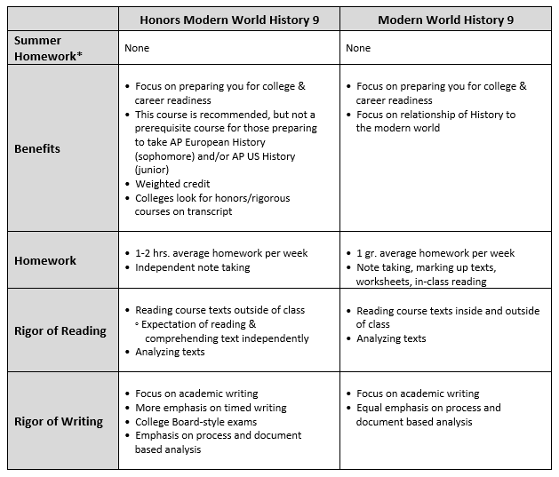
What’s the difference?

Slide 15
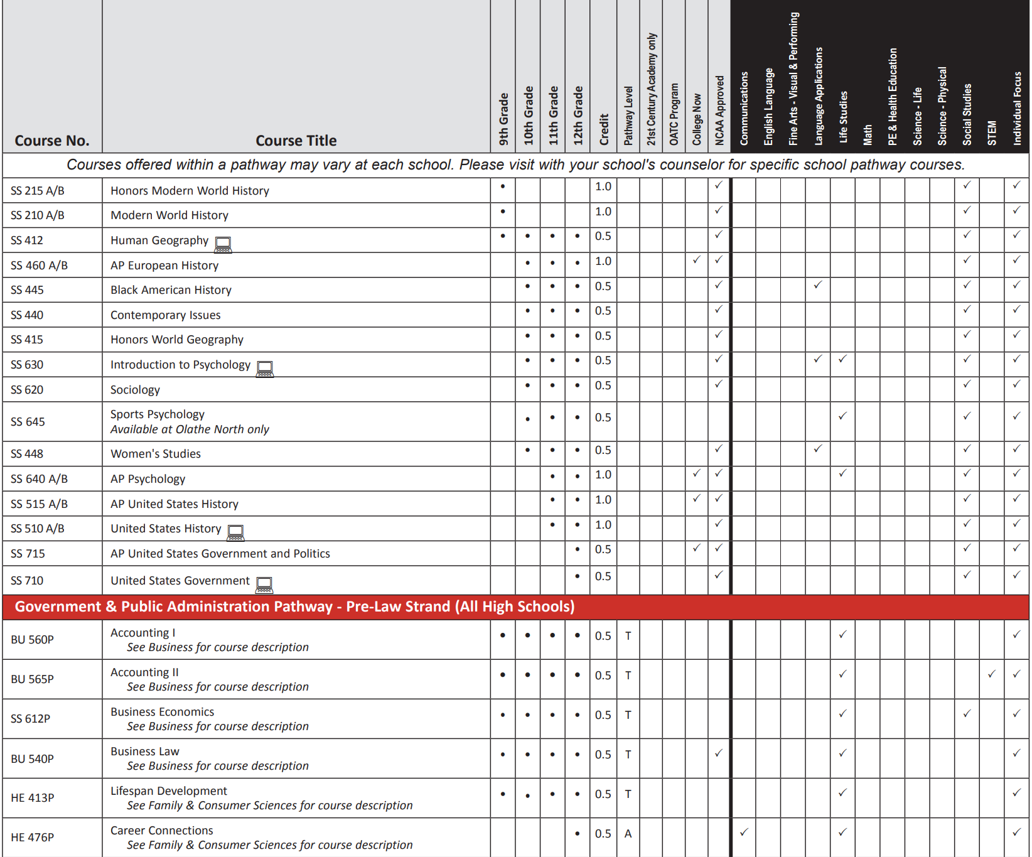
What are Social Studies electives?

Slide 16
Physical Education + Health 0.5 credit PE + 0.5 credit Health Page 50
» Physical Education Concepts + Health are required your freshman year
» Cheerleading or Dance Team will replace your Physical Education + Health credits
» It is recommended that any student athlete add Strength & Conditioning as an elective.

Slide 17
Fine/Performing Arts 1.0 credit
Performing:
Visual:
See page 39 for full list!
» Acting » Argumentation & Debate » Concert Band » Concert Choir » Concert Orchestra » Forensics: Interscholastic Speech & Drama » Technical Theatre
See page 43 for full list!
» Basic Digital Photography » Ceramics » Drawing » Jewelry/Metals » Painting » Sculpture

Slide 18
Applied Language 1.0 credit
Language Application:
World Language:
See page 10 for full list!
» Acting » Black American History » Creative Writing » Graphic Design » Novice Debate » Video Production
See page 70!
» American Sign Language I-III » French I-V » German I-IV » Japanese I-IV (only at ONW) » Spanish I-V » Spanish for Heritage Speakers I-III

Slide 19
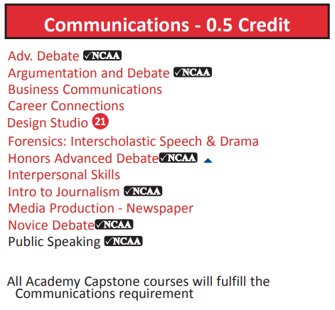
Communications 0.5 credit Page 10

Slide 20
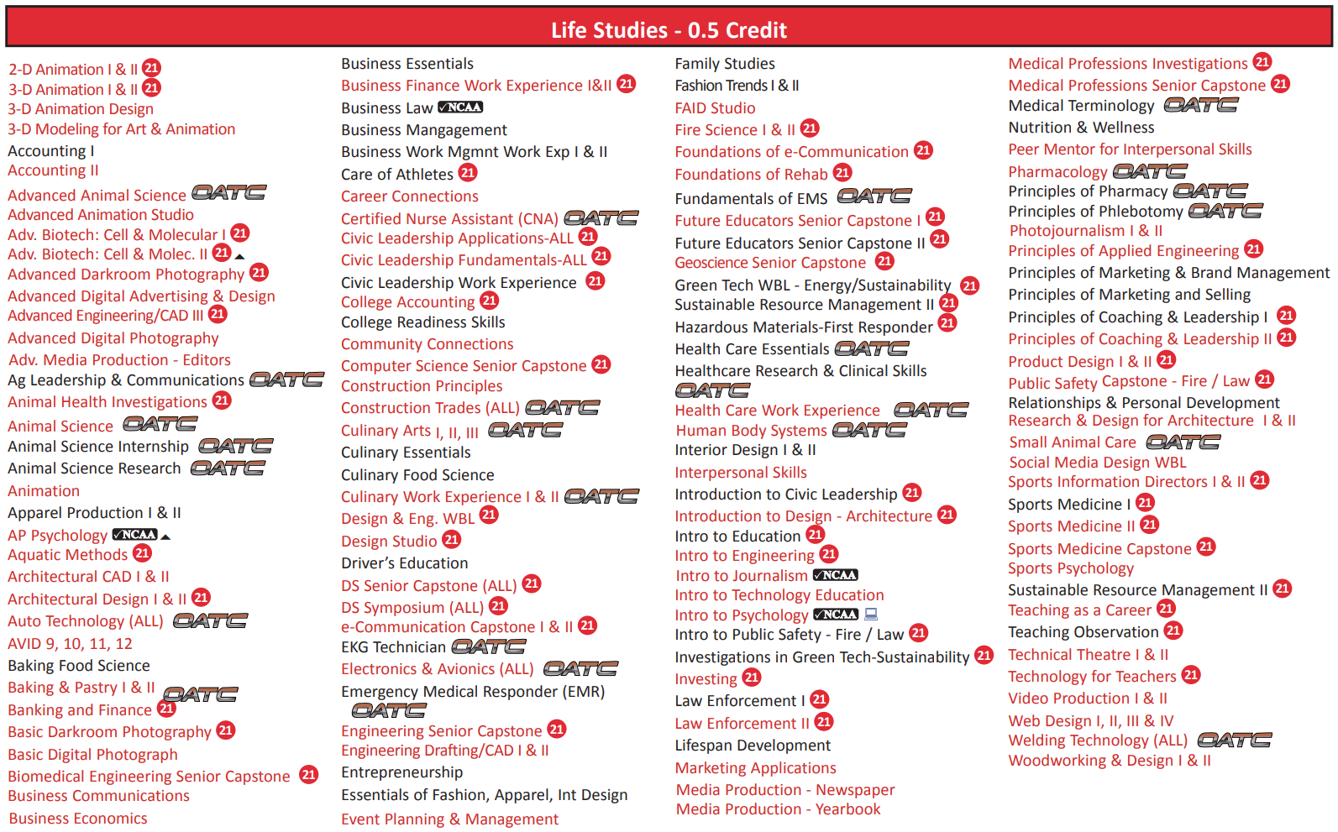
Life Studies 0.5 credit Page 11

Slide 21
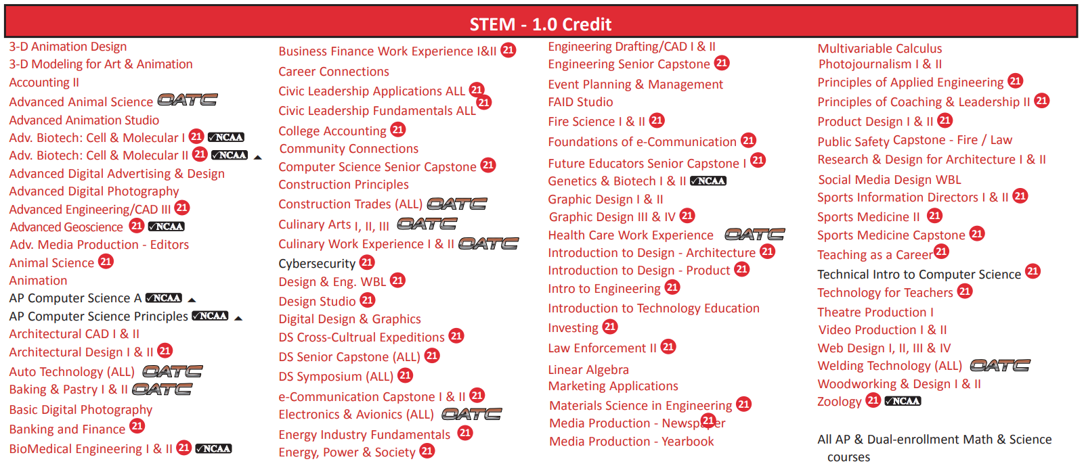
STEM 1.0 credit Page 11

Slide 22
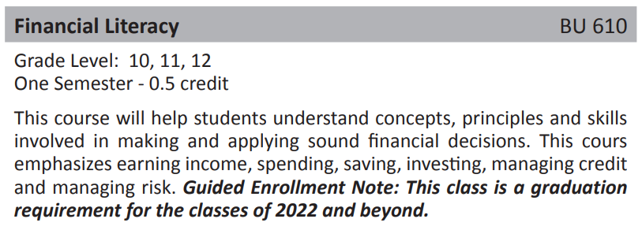
Financial Literacy 0.5 credit Page 17

Slide 23
What about the rest?
Let’s say you take Spanish I next year (your freshman year). That would fulfill your Applied Language requirement. If you were to take Spanish II your sophomore year, it would fill one (1.0 credit) of your Individual Focus/Electives requirement.

Slide 24
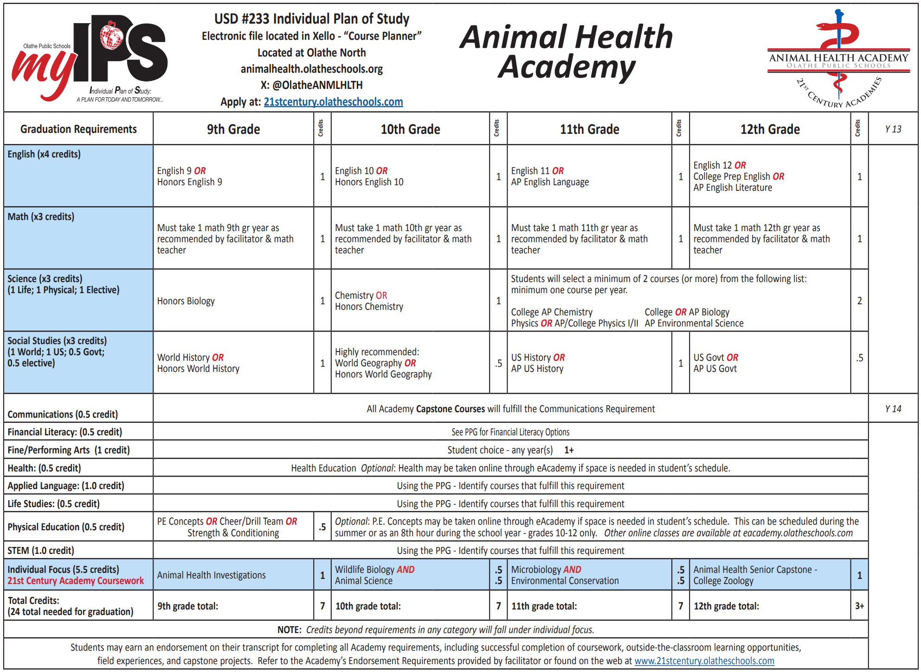
If you are in a 21st Century Academy:

Slide 25
Athletics and Activities
ELIGIBILITY:
HIGH SCHOOL LEVEL: You must have passed 5 out of 7 classes the previous semester to play/participate…that means your grades this semester determine if you will be eligible for fall sports and activities next year!

Slide 26
Athletics and Activities
» Baseball » Basketball » Bowling » Cheerleading » Cross-Country » Dance Team » Debate » Football » Forensics
» Golf » Gymnastics » Soccer » Softball » Swimming » Tennis » Track and Field » Volleyball » Wrestling

Slide 27
Enrollment Process
January 28th – Enrollment presentation during Language Arts February 11th – Enrollment during Social Studies February 24th & 25th – Enter IPS (2 Year Plan) into Xello during Language Arts

Slide 28
Questions?

