Slide 1
TEEN MENTAL HEALTH
What Parents Need to Know
Stephanie Allegre, LSCSW & Jenna Dammerich, LMSW

Slide 2
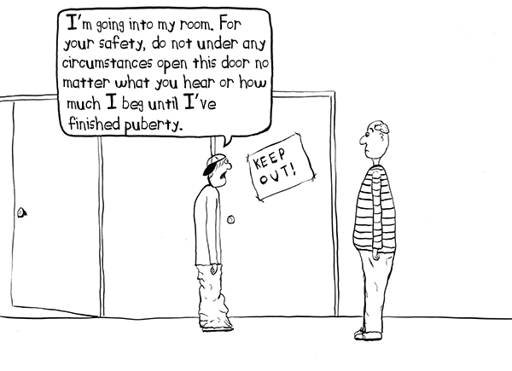

Slide 3
What are the stats?
Anxiety is the #1 mental health disorder among teens today
Mean age of onset is 11; Girls diagnosed more often than boys
About 20% of teens experience depression before they reach adulthood
More than 1 in 20 US teens have anxiety or depression, often coexist
Suicide is the #2 cause of death among ages 10-24
Boys are more likely to die from suicide, while girls are more likely to report attempting suicide
Notes:
Mental health is on the rise in young people for many reasons. Parents have an opportunity to help facilitate change and healthy habits.

Slide 4
What should I look for?
Anxiety
Feelings of constant, exaggerated worry and tension
Always expecting the worst
Fear of failure
Difficulty sleeping, nightmares
Unexplained physical symptoms: stomachache, headache, tiredness
Intense anxiety about being in social situations
Fear of being rejected or humiliated
Racing thoughts and rapid heart rate
Fear of losing control or having a heart attack
Fear for the safety of primary caregivers
Notes:
Often, these fears and worries are irrational and negatively impact students’ day-to-day functioning; may look like depression or be dually diagnosed

Slide 5
What should I look for?
Depression
Lack of energy or motivation
Lack of interest in activities that used to be enjoyable
Difficulty with schoolwork
Sadness and hopelessness
Anger and rage; rebelliousness
Feelings of being overwhelmed or inadequate
Problems making decisions
Changes in sleeping or eating habits
Isolation from peers and family
Signs of self harm
Notes:
Don’t confuse depressive symptoms with typical teenage independence and angst. Know the signs.

Slide 6
What should I look for?
Suicidal Ideation
Threats of suicide
Dramatic change in personality or appearance
Deep sense of hopelessness for a better tomorrow
Changes in eating or sleeping patterns
Lack of interest in future plans
Verbal hints such as, “I won’t be here” or “It won’t matter”
Putting affairs in order
Change in school performance
Notes:
It’s not often blatant. So, have conversations with kids, even if it’s uncomfortable. Talking about it won’t cause suicide.
Make sure you are monitoring social media usage. Often this is a place where young people vent about emotions or leave hints about how they’re doing/feeling

Slide 7
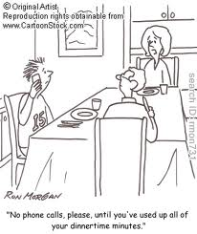

Slide 8
Where is this angst coming from?
Heavy academic, extracurricular, work and/or social demands
School is performance-based, heavy testing
Loss of a loved one or a major change in the family
Electronics offer an unhealthy escape
Kids are protected from experiencing disappointment, sadness, failure, anger and guilt
Social media dictates who they should be, with emphasis on appearance
Parents get caught up in the rat race of keeping up with the Jones’
Parents are parenting out of guilt and fear
Family hierarchies are mixed up
Kids are barometers for what is going on in the family
Constant media reports of violence
Bullying has become a 24/7 threat
Notes:
Students: heightened concern for safety, social status, academic success
Parents: removing opportunities for students to fail, step out of comfort zone, fight own battles; heightened concern with social status, living vicariously through kids
Lacking appropriate family connections and roles

Slide 9
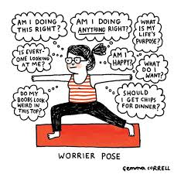

Slide 10
Calming your anxious child
I am here and you are safe…Can you tell me about it?
Allow child to talk about their fear without interrupting or trying to fix it.
Encourage kids to come up with phrases to talk back to their “bully in the brain.”
Create and review a list of calming strategies
What do you need from me?...Give kids an opportunity to tell you, don’t assume you know
Use creative ways to express their feelings: writing, drawing, physical activity, tell the story in a new way, etc.
Empower by researching the fears together
Help them refocus from “worst case” to “most likely” outcome
Notes:
Let your child be the expert on themselves (only they know what they are truly feeling), then validate, and help guide with suggestions/ideas

Slide 11
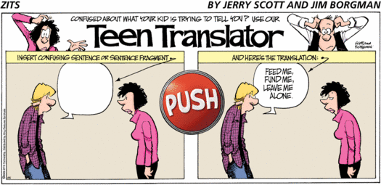

Slide 12
Eight things kids wish parents knew
I need time alone…don’t take it personally.
Please don’t compare me to my friends, or even my siblings.
I’m not you. I have my own likes and dislikes and I have my own opinions.
Your identity shouldn’t be based on my performance in school, sports, theatre, music, etc.
Don’t invalidate my stress, my thoughts, or my feelings, even if they seem trivial and immature.
I would like for you to admit when you’re wrong and apologize.
Trust that I’ve learned what you’ve taught me, even though I will sometimes make dumb mistakes.
Sometimes I just need for you to listen.

Slide 13
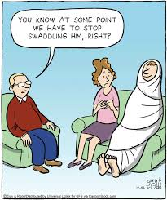

Slide 14
How do we build resilience in kids?
re·sil·ience /rəˈzilyəns/ noun 1. the capacity to recover quickly from difficulties; toughness.
Teach kids to problem-solve
Give kids developmentally-appropriate freedom and responsibilities
Allow your kids to make and learn from their mistakes
Ask how and what questions rather than why questions
Keep your emotions in check…don’t flip out in front of the kids
Teach that fair isn’t always equal
Teach kids that all emotions are OK, normalizing anxiety and fear
Model the behavior you want from your child
Teach kids how to communicate what they want and need
Create opportunities for your kids to help others
Recognize and praise small accomplishments
Encourage small steps outside of their comfort zone (exposure therapy)
Notes:
Across the district, we’re talking to our middle schoolers about grit. This falls in line with what we’re targeting…what you can be doing to reinforce it at home.

Slide 15
Therapeutic strategies
Assist your child in creating an imaginary container to store their worries; (compartmentalization)
Name the “bully in your brain”
Teach positive self-talk
Thoughts→ Feelings→ Behavior (CBT)
Identify a safe place for your child to go
Emphasize that a thought is not a fact
Avoid all-or-nothing statements
Plan for and discuss transitions
Teach how to recognize physical symptoms of stress and encourage breaks
Model deep breathing
Distract using the remote control technique
Allow anxiety to be present without judgment…it’s not good or bad, it just is
Encourage “I” statements
Notes:
One of the reasons the I-‐Statement is so useful is because it lets us share our feelings in a calm way that does not make someone else defensive. It also helps us to understand the connection between events, thoughts, and emotions

Slide 16
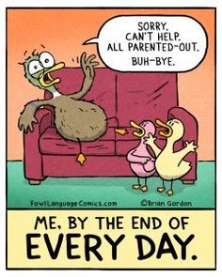

Slide 17
“What about my mental health?”
Self Care Is Good…For You & The Kids
Social support
Adequate sleep
Healthy diet
Learn to say NO!
Rediscover your personal identity
Eliminate toxic people
Date night
Indulge yourself
Spirituality
Find time to be alone and porch sit
Notes:
Metaphor about putting your mask on before your kid’s on an airplane.

Slide 18
What Next?
Suicide Support
Other Support
National Suicide Prevention Lifeline
Johnson County Mental Health
University of Kansas Health Systems Marillac Campus
Research Hospital
Children’s Mercy Hospital
Emergency room
Call 911
Connect with the school
OPS’s Help Clinic
Psychologytoday.com
Employee assistance program (EAP)
Pediatrician

